Slide 1
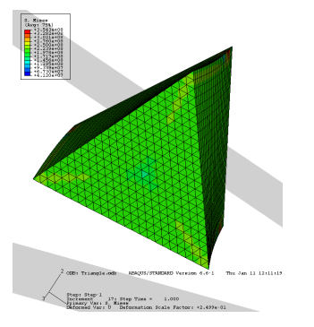
Project V:
FEM Calculation of Warping (Saint-Venant Torsion)
Group II:
Andy Nguyen, Brian Tam , Jannette Choi, Chris Chin,
Matthew Yeung, Sam Liu, Celina Shaw, & Sean Yen

Slide 2

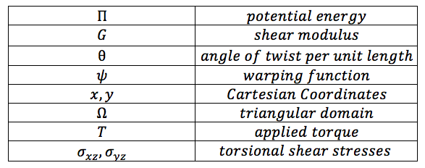
St. Venant Torsion Problem
Prismatic non-circular bar elastic potential energy:

Slide 3

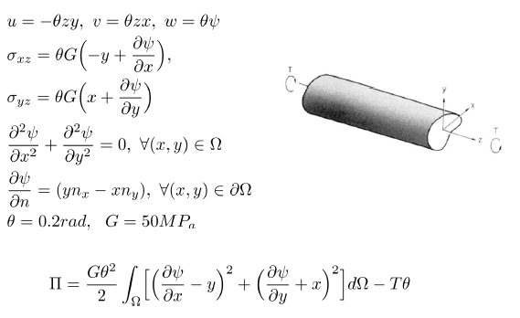
St. Venant Torsion Problem
Solving for:
Given:
Notes:
The warping function is independent from theta (angle of twist)
The problem is asking us to find the warping function, torsional shear stresses, applied torque, and plot for the warping function.
Following the general summary of St. Venant’s torsion theory, and the condition of the angle of twist and G, we can derive and calculate the requested parameters.

Slide 4
Overview of Steps
Derive the weak form
Constraints and Boundary Condition
Making our Shape Functions and K Matrix
From Theory to Matlab
Solving T and shear stresses
Question and Answer

Slide 5
1.
Derive the weak form

Slide 6
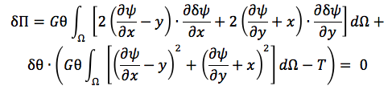

Derive the weak form
Starting with the potential energy equation of a prismatic non-circular bar:
Using the variational derivative to get the weak form:

Slide 7













Derive the weak form
Integrating by parts:

Slide 8
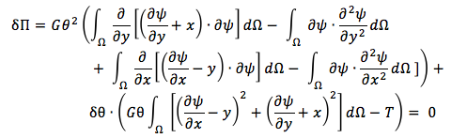


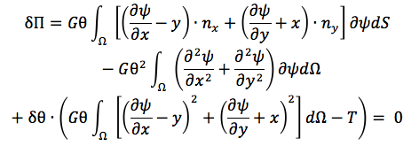
Derive the weak form
Continued:
Divergence theorem:

Slide 9
2.
Constraints and Boundary Condition

Slide 10
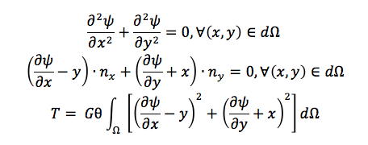
Constraints and Boundary Condition
Constraints:
Boundary condition: Fixed in the middle!

Slide 11
3.
Making our Shape Functions and K Matrix

Slide 12
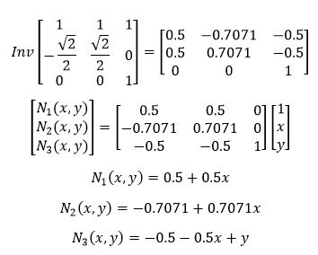



3. Making our Shape Functions and K Matrix

Slide 13
4.
From Theory to Matlab

Slide 14
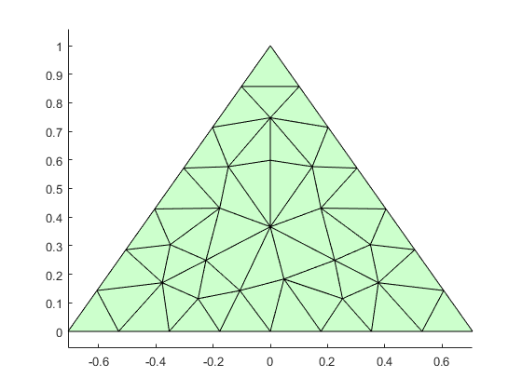
Matlab - pmesh plot
Boundary node matrix:
16
e 17 15
18 14
19 13
20 12
21 11
22 10
1 2 3 4 5 6 7 8 9

Slide 15
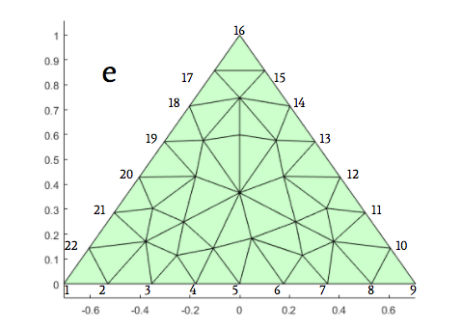
Matlab
Node 23 - This point remains fixed. Doesn’t displace due to torsion.

Slide 16
Matlab - fempoi function
function u = fempoi(p,t,e)
% size of the system
N = size(p,1); T = size(t,1);
% matrix allocation
A = sparse(N,N); b= zeros(N,1);
Ak = zeros(3,3); bk = zeros(3,1);
theta = 0.2;
for i = 1:T
x1 = p(t(i,1),1);
x2 = p(t(i,2),1);
x3 = p(t(i,3),1);
y1 = p(t(i,1),2);
y2 = p(t(i,2),2);
y3 = p(t(i,3),2);
% get the node coordinates of triangle k
V = [1,x1,y1;
1, x2,y2;
1, x3,y3];
% area of the triangle(area = 1/2*|a x b|)
%area = 0.5*abs((V(2,2)-V(1,2))*(V(3,3)-V(1,3))-(V(2,3)-V(1,3))*(V(3,2)-V(1,2)));
area = 0.5*abs(det(V));
% coefficients of the shape functions
C = inv(V);
% element stiffness matrix and force vector
for ik = 1:3
for jk = 1:3
Ak(ik,jk) = C(2,ik)*C(2,jk) + C(3,ik)*C(3,jk);
end
bk(ik) = area/3;
end
% assembly, global stiffness and force vector
A(t(i,:),t(i,:)) = A(t(i,:),t(i,:)) + Ak*area;
b(t(i,:)) = b(t(i,:)) + bk;
end
for i = 1:length(e)
for j = 1:N
A(23,j) = 0; A(j,23) = 0;
end
A(e(i),e(i)) = 1; b(e(i)) = 1;
end
% solve the system;
u = A\b;
end

Slide 17
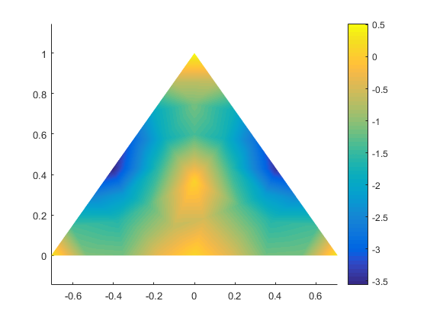

Matlab
Psi
% Triangle, all Dirichlet
a= sqrt(2)/2;
pv=[-a,0;a,0;0,1;-a,0];
[p,t,e]=pmesh(pv,0.2,0);
u=fempoi(p,t,e);
figure; tplot(p,t,u)

Slide 18
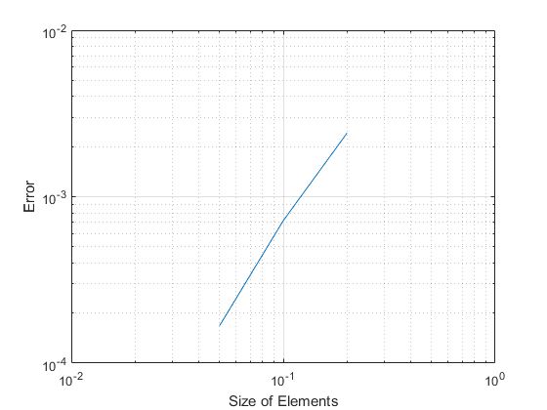
Matlab - Error Plot
close all; clear all; clc; hmax=0.2; for pv={[-sqrt(2)/2,0;sqrt(2)/2,0;0,1;-sqrt(2)/2,0]} errors=poiconv(pv{1},hmax,3) loglog(hmax./2.^(0:2),errors), grid; rate=log2(errors(end-1))-log2(errors(end)) xlabel('Size of Elements') ylabel('Error') end
Notes:
WHAT DIS

Slide 19
5.
Solving for T and shear stresses

Slide 20
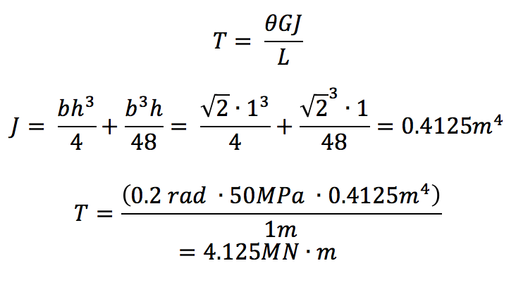
5. Solving for T
Notes:
To find torque, integrate the torsional stress over the triangular cross-section area, which gives you this equation. Theta and G are given, so all we need is J, which is the polar moment of inertia of an isosceles triangle. Torque is 4.125 Meganewton-meters

Slide 21
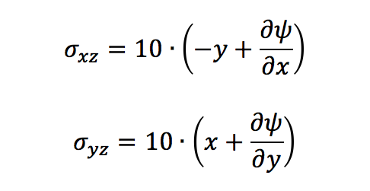
5. Calculating shear stresses

Slide 22
6.
Question and Answer

